Slide 1
Introduction to Data Structure
Odedra Viraj
Computer Sciences
College of Engineering
Darshan University

Slide 2
Outline
Data, Big Data and Challenges
Data Science
Introduction
Why Data Science
Data Scientists
What do they do?
Major/Concentration in Data Science
What courses to take.

Slide 3




Data All Around
Lots of data is being collected and warehoused
Web data, e-commerce
Financial transactions, bank/credit transactions
Online trading and purchasing
Social Network

Slide 4
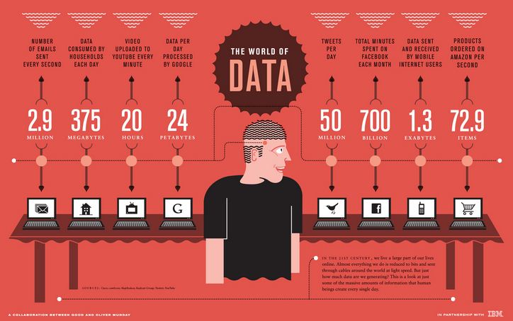
How Much Data Do We have?
Google processes 20 PB a day (2008)
Facebook has 60 TB of daily logs
eBay has 6.5 PB of user data + 50 TB/day (5/2009)
1000 genomes project: 200 TB
Cost of 1 TB of disk: $35
Time to read 1 TB disk: 3 hrs
(100 MB/s)

Slide 5
Big Data
Big Data is any data that is expensive to manage and hard to extract value from
Volume
The size of the data
Velocity
The latency of data processing relative to the growing demand for interactivity
Variety and Complexity
the diversity of sources, formats, quality, structures.

